Slide 1
.NET
Free. Cross-platform. Open source.
A developer platform for building all your apps.
www.dot.net

Slide 2














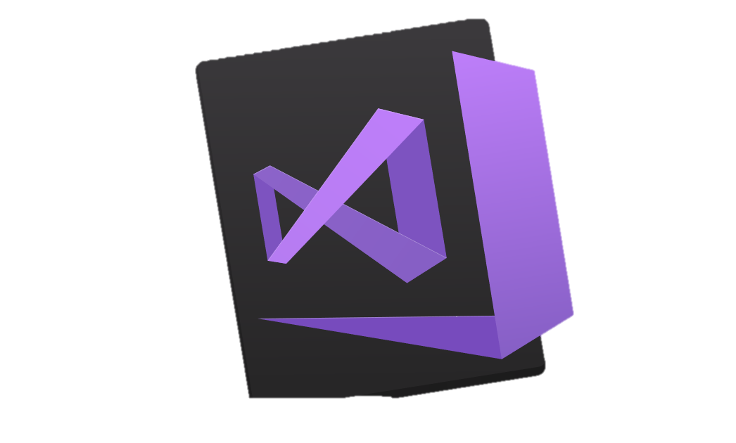
Your platform for building anything
DESKTOP
WEB
CLOUD
MOBILE
GAMING
IoT
AI
.NET
Visual Studio
Visual Studio for Mac
Visual Studio Code
Command Line
Your editor
Notes:
You can build anything with .NET. We’ve made significant investments in .NET over the years as well as unifying the ecosystem to support building literally anything. From desktop to gaming to the cloud, .NET is a general purpose programming platform that enables all kinds of scenarios. Once you learn one, you can easily pick up another.
<CLICK>
What’s more, you can also use your favorite tools and editors to build .NET apps – or use Visual Studio, Visual Studio Code or Visual Studio for Mac.

Slide 3




.NET ecosystem momentum
>1.5M .NET Core developers
#1 Most Loved
Framework
Top 30
Highest velocity OSS projects
.NET Core
github.com/dotnet github.com/aspnet
in Visual Studio
Top 5
Language on GitHub
7x
Faster than Node.js
40%
New to .NET are students
C#
ASP.NET Core
dot.net download survey
insights.stackoverflow.com/survey/2019#most-loved-dreaded-and-wanted
github.com/cncf/velocity/
octoverse.github.com/
www.techempower.com/benchmarks/#section=data-r18&hw=ph&test=plaintext
Notes:
We are seeing significant growth….
Talk to data points above
-----
Additional data points –
-C# moved from 7th to 5th in TIOBE Language Index 2020
-.NET Core 3 is fastest adopted version of .NET, ever
-dotnet org on GitHub has been top 3 highest velocity projects three years in a row as named by CNCF (see slide 13 for details)
Sources:
https://insights.stackoverflow.com/survey/2019#most-loved-dreaded-and-wanted
https://github.com/cncf/velocity/
https://octoverse.github.com/
https://www.techempower.com/benchmarks/#section=data-r18&hw=ph&test=plaintext

Slide 4
.NET adoption
Visual Studio
.NET Core
.NET on Linux
+1 million new monthly active .NET developers in last year
+600K new monthly active developers in last year
>1 million publishes from Visual Studio to Linux
Notes:
And our user base keeps growing!
We’ve seen significant growth with .NET Core, our open source, cross-platform .NET, now has surpassed 1.5 million active developers per month and we’ve seen over 600 thousand new developers in the last year.
We’re also now seeing over 1 million deployments to Linux from Visual Studio.
<CLICK>

Slide 5
.NET is Fast. Really Fast!
2.22M
0.73M
requests / sec
0.53M
requests / sec
requests / sec
Java Servlet
.NET Core
Node.js
Data sourced from official tests available at TechEmpower Round 15.
“Using the same-size server, we were able to go from 1,000 requests per second per node with Node.js to 20,000 requests per second with .NET Core.“ — Raygun
https://www.microsoft.com/net/customers
Notes:
.NET is fast. Really fast! That means applications provide better response times and require less compute power. StackOverflow serves 5.3M page views a day on just 9 servers!
The popular TechEmpower benchmark compares web application frameworks with tasks like JSON serialization, database access, and server side template rendering - .NET performs faster than any other popular framework.
https://www.techempower.com/benchmarks/#section=data-r14&hw=ph&test=plaintext
The community has played a crucial role in performance work for the .NET stack.
https://blogs.msdn.microsoft.com/dotnet/tag/performance/

Slide 6

Stack Overflow completes their migration to .NET Core 3.1
Stack Overflow sees better performance, faster development, and containerization benefits with .NET Core.
Notes:
https://www.youtube.com/watch?v=1DIDWWKk8Bg
.NET is fast. Really fast! That means applications provide better response times and require less compute power. StackOverflow serves 5.3M page views a day on just 9 servers!
The popular TechEmpower benchmark compares web application frameworks with tasks like JSON serialization, database access, and server side template rendering - .NET performs faster than any other popular framework.
https://www.techempower.com/benchmarks/#section=data-r14&hw=ph&test=plaintext
The community has played a crucial role in performance work for the .NET stack.
https://blogs.msdn.microsoft.com/dotnet/tag/performance/

Slide 7
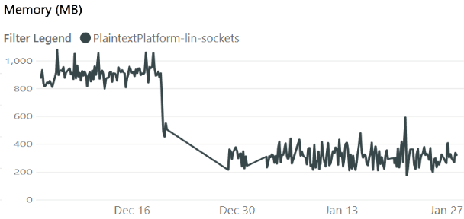
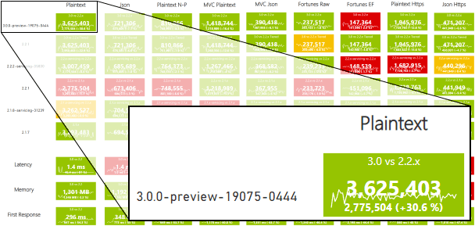
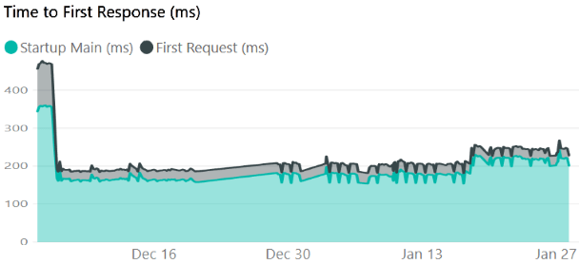

… and is getting even faster
https://aka.ms/aspnet/benchmarks
6 minutes, 64 connections, 120.000.000 requests
Notes:
.NET is fast. Really fast! That means applications provide better response times and require less compute power. StackOverflow serves 5.3M page views a day on just 9 servers!
The popular TechEmpower benchmark compares web application frameworks with tasks like JSON serialization, database access, and server side template rendering - .NET performs faster than any other popular framework.
https://www.techempower.com/benchmarks/#section=data-r14&hw=ph&test=plaintext
The community has played a crucial role in performance work for the .NET stack.
https://blogs.msdn.microsoft.com/dotnet/tag/performance/

Slide 8
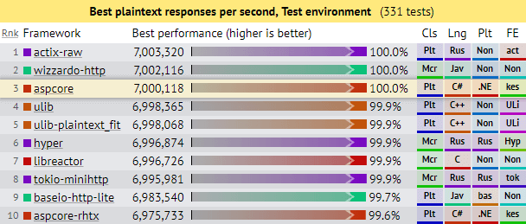
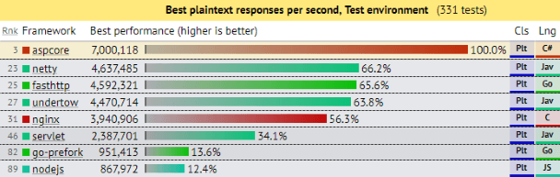
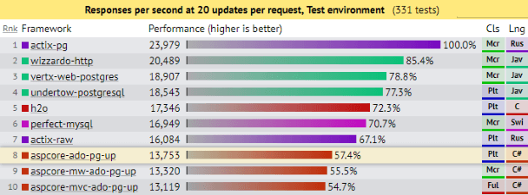
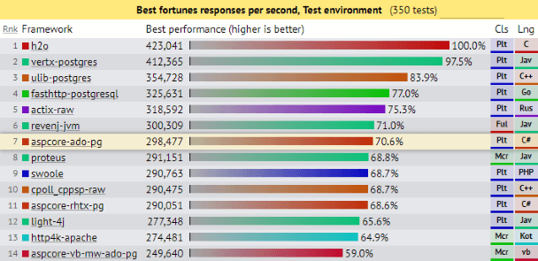
.NET is Fast. Really Fast!
Notes:
.NET is fast. Really fast! That means applications provide better response times and require less compute power. StackOverflow serves 5.3M page views a day on just 9 servers!
The popular TechEmpower benchmark compares web application frameworks with tasks like JSON serialization, database access, and server side template rendering - .NET performs faster than any other popular framework.
https://www.techempower.com/benchmarks/
The community has played a crucial role in performance work for the .NET stack.
https://blogs.msdn.microsoft.com/dotnet/tag/performance/
https://www.ageofascent.com/2019/02/04/asp-net-core-saturating-10gbe-at-7-million-requests-per-second/

Slide 9
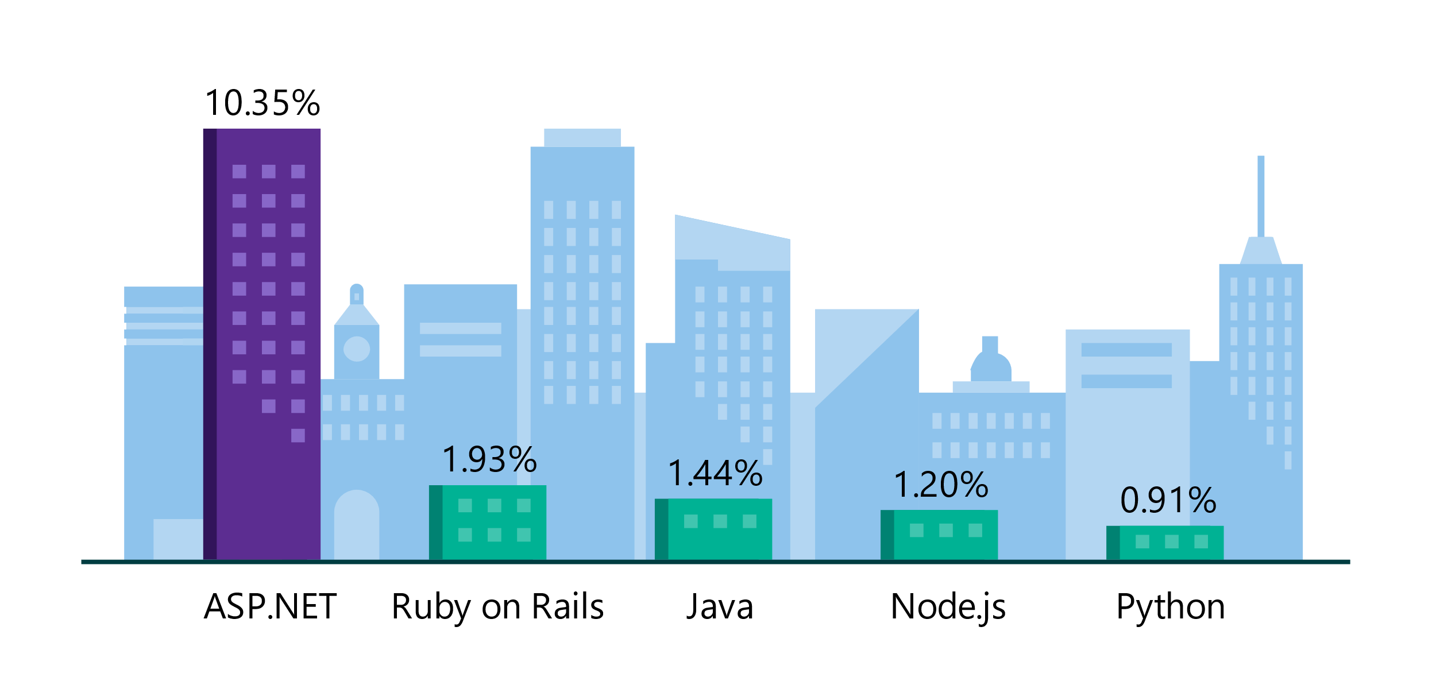
.NET is the platform of choice for the top 100K websites
More websites have been developed with ASP.NET than Ruby, Java, Python, Node.js, and Go combined.
Companies like Raygun, GoDaddy, and Tencent choose .NET for better performance, increased flexibility, and higher compatibility.
Data sourced from SimilarTech
Notes:
https://www.similartech.com/categories/framework
ASP.NET is the name of the web framework for .NET. As you can see there are more top websites developed with .NET than these other technologies. Only PHP has more.

Slide 10


.NET is Open Source
Community Accepted PRs
“Samsung is embracing .NET because it is a completely open source project.” — Samsung
".NET is open source; that allows us to contribute back to it if we have any performance issues which Microsoft review and together we make a better product.“ — Illyriad Games
16,000+ Community Contributions from 3000+ Companies outside Microsoft
Notes:
We’ve seen companies taking a bet on .NET because it’s a completely open source project. More than 16,000 contributors* from 3300 companies have contributed to .NET Core and related open source repositories, with over half of the contributions coming from outside Microsoft.
Samsung is a big partner and are releasing their new Smart TVs that support .NET. They plan to expand to all their IoT devices too. Illyriad Games, specifically Ben Adams, contributed many performance enhancements to the platform. They build a MMO with hundreds of thousands of concurrent users so performance is super important to them. These enhancements not only benefit them but everyone that uses .NET.
*contributor = Submitted a Pull Request or Created an Issue

Slide 11


.NET Open Source Journey
2001- ECMA-335
2002- .NET 1.0 for Windows released, Mono project begins
April 2014- .NET Compiler Platform (“Roslyn”) Open Source .NET Foundation founded
Nov 2014- .NET Core Cross-plat, Open Source
2008- ASP.NET MVC (web platform) Open Source
.NET
Aug 2017- .NET Core 2
2016- Mono project joins .NET Foundation
Notes:
This didn’t happen overnight. Here’s a little history of .NET open source…..
Dec 2001-Feb 2002.
A new platform is born. Along with HP, Intel and others, the ECMA-335 standard was created that defined a common language infrastructure to support multiple programming languages. C# and Visual Basic.NET were released and F# came later in 2007, but there are over 20 other .NET languages today. Visual Studio .NET was released and included C#, VB, C++ development all in one box. This was the first IDE that was truly integrated across multiple languages.
Mono project begins. The CLI spec gave others the ability to create their own .NET implementations. Even though Microsoft built the first .NET Framework for Windows-only, the spec was intentionally portable across OSes and chipsets. The Mono project began, spearheaded by Miguel de Icaza, with the goal to implement Microsoft's new .NET development platform on Linux and Unix-like platforms. Later, Miguel started Xamarin which focused on cross-platform, native, mobile development with C#, built upon Mono. This allows developers to use C# and .NET to build apps for iOS and Android. Unity games development also emerged from Mono.
2008.
ASP.NET MVC web development stack is released to CodePlex as open source. This was the first application development framework from Microsoft to be released as open source. The underlying runtime and compilers were still closed however.
2014.
Hell freezes over & pigs fly. Early 2014 at Microsoft’s BUILD conference, Anders Hejlsberg, the father of C#, releases the .NET Compiler Platform “Roslyn” as open source on stage. Later in November, .NET Core project begins in the open. The technology world is shocked, and the .NET community is excited. .NET Core is a new cloud-native implementation of .NET that is geared for cross-platform, hyper-scale services as well as small IoT devices. It’s meant to bring .NET into the next 15 years of computing. And the community has been extremely supportive.
2016.
Mono comes home. In early 2016, Microsoft finally acquires Xamarin and brings Miguel de Icaza into Developer Division. Mono joins the .NET foundation and is officially supported and contributed to by Microsoft. The Microsoft community officially meets the Mono community.
2017.
.NET Core 2.0 Released. Our cross platform and open source implementation of .NET finally releases to the world with unified tooling support across multiple operating systems and editors.

Slide 12
The .NET Roadmap
Many
.NETs
2014
.NET FRAMEWORK
.NET CORE
XAMARIN / MONO
Runtime
Runtime
Runtime
Base class library
Core library
Mono class library

Slide 13
The .NET Roadmap
Many
.NETs
.NET
standard
2014
2016
.NET FRAMEWORK
.NET CORE
XAMARIN / MONO
Runtime
Runtime
Runtime
Base class library
Core library
Mono class library
.NET STANDARD

Slide 14
The .NET Roadmap
Many
.NETs
.NET
standard
.NET
2014
2016
Next
.NET FRAMEWORK
.NET CORE
.NET
XAMARIN / MONO
Runtime
Runtime
Runtime (JIT & native)
Runtime
Core library
Base class library
One base class library
Mono class library
.NET STANDARD
Notes:
Mono merguje sie do .net core (juz jest)
A .net framework wymiera

Slide 15

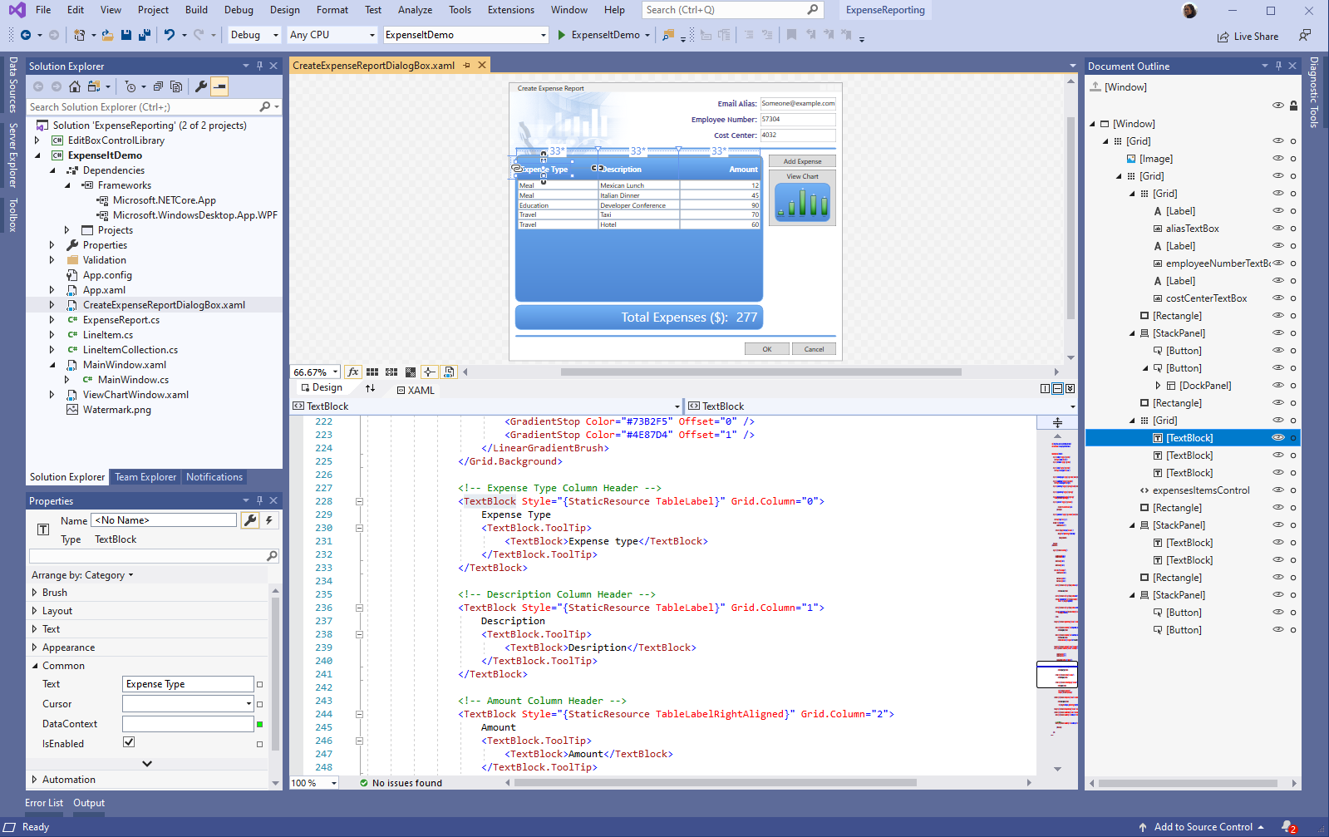
RELEASED
.NET Core 3.1
Long-Term Support (LTS)
WPF and Windows Forms support
Side-by-side support & self-contained EXEs
Modern web UI with ASP.NET Blazor
New C# 8.0 language features
dot.net/get-core3
Notes:
Don’t forget we released .NET Core 3.1 LTS release. This is the version you want to be on as it is our latest long-term support release so download it today.
We’ve added Windows Desktop support with Windows Forms and WPF support. This brings the capabilities of .NET Core to these UI frameworks which millions of .NET developers are building on today. Particularly useful is the flexible deployment with side-by-side and self-contained EXEs so you don’t have to have .NET installed on the machine first anymore.
We also have some exiting new things for Web developers with Blazor, adding full-stack web development with C# and Razor, allowing you to build beautiful and responsive Single Page Apps without having to write JavaScript!
Additionally we have a ton of improvements for building better cloud native, scalable apps and microservices with ASP.NET and of course some exciting C# 8.0 language features.

Slide 16
One .NET vision – .NET 5 to 6 "wave"
.NET Framework
Single SDK, one BCL, unified toolchain
Cross-platform native UI
Cross-platform web UI
Cloud native investments
Continue improvements in speed, size, diagnostics, Azure services
.NET
.NET Core
Mono / Xamarin
.NET has the best of breed solutions for all modern workloads
Notes:
Animated slide
Our vision for one .NET is to simplify the platform and choices for .NET developers and provide a single stack that supports the best of breed solutions for all modern workloads.
Last year at Build, we laid out our vision for one .NET starting with .NET 5. We said we would take .NET Core and Mono/Xamarin implementations and unify them into one base class library (BCL) and toolchain (SDK). In the wake of the global health pandemic, we have had to adapt to the changing needs of our customers and provide the support needed to assist with smooth operations. Our efforts continue to be anchored in helping our customers address their most urgent needs. As a result, we expect these features to be available in preview for the .NET 5 release but the unification will be truly completed with .NET 6, our Long-Term Support (LTS) release. Our vision has not changed, but our timeline has.
.NET 5 will have several cloud & web investments, such as smaller, faster, single file EXEs that use less memory which are appropriate for microservices and containerized applications across operating systems. We will continue to build on the work we have done.
We are still committed to one .NET platform and delivering a quality .NET 5 release to our millions of users in November this year. You will continue to see a wave of innovation happening with multiple previews along the way on the journey to one .NET.

Slide 17
.NET 5 to .NET 6 “wave”
Supports all .NET application types
Evolution of .NET Core, adding the best of Mono into one unified platform
One BCL implementation, still adheres to .NET Standard
One toolchain (SDK style projects)
Both Just-in-Time (JIT) and native models supported
Interop with Java and Swift

Slide 18







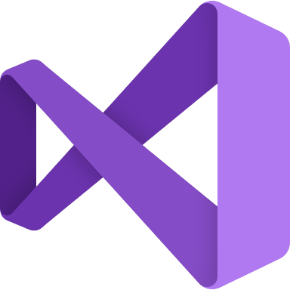



.NET - a unified platform
TOOLS
DESKTOP
WEB
CLOUD
MOBILE
GAMING
IoT
AI
WPF
Windows forms
UWP
ASP.NET
Azure
Xamarin
Unity
ARM32
ARM64
ML.NET
.NET for Apache Spark
VISUAL STUDIO
.NET STANDARD
VISUAL STUDIO FOR MAC
.NET 5
VISUAL STUDIO CODE
INFRASTRUCTURE
RUNTIME COMPONENTS
COMPILERS
LANGUAGES
COMMAND LINE INTERFACE

Slide 19
.NET Schedule
July 2019
.NET Core 3.0
RC
Sept 2019
.NET Core 3.0
Nov 2019
.NET Core 3.1
LTS
Nov 2020
.NET 5.0
Nov 2021
.NET 6.0
LTS
Nov 2022
.NET 7.0
Nov 2023
.NET 8.0
LTS
.NET Core 3.1 = Long term support (LTS)
.NET 5.0 release in November 2020
Major releases every year, LTS for even numbered releases
Predictable schedule, minor releases if needed

Slide 20
Cloud native investments
Faster cross-platform development with WSL
Smaller microservices, single file EXE, top-level C# programs (C# 9.0)
Opinioneted .NET microservices & orchestration tool “Project Tye”
High-performance reverse proxy “Project YARP”

Slide 21
Learn more

Slide 22
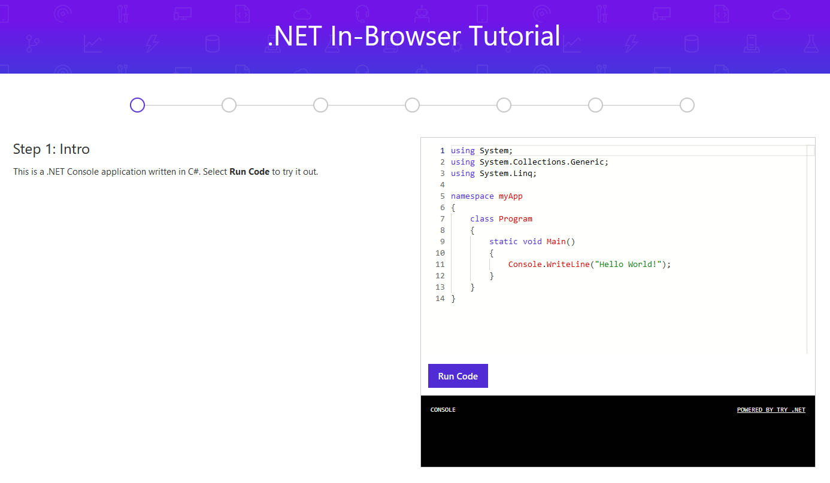
Learn how to program with C#
try.dot.net
Notes:
So you want to learn .NET? Start with a language. We make it easy to get started learning right in your browser.

Slide 23
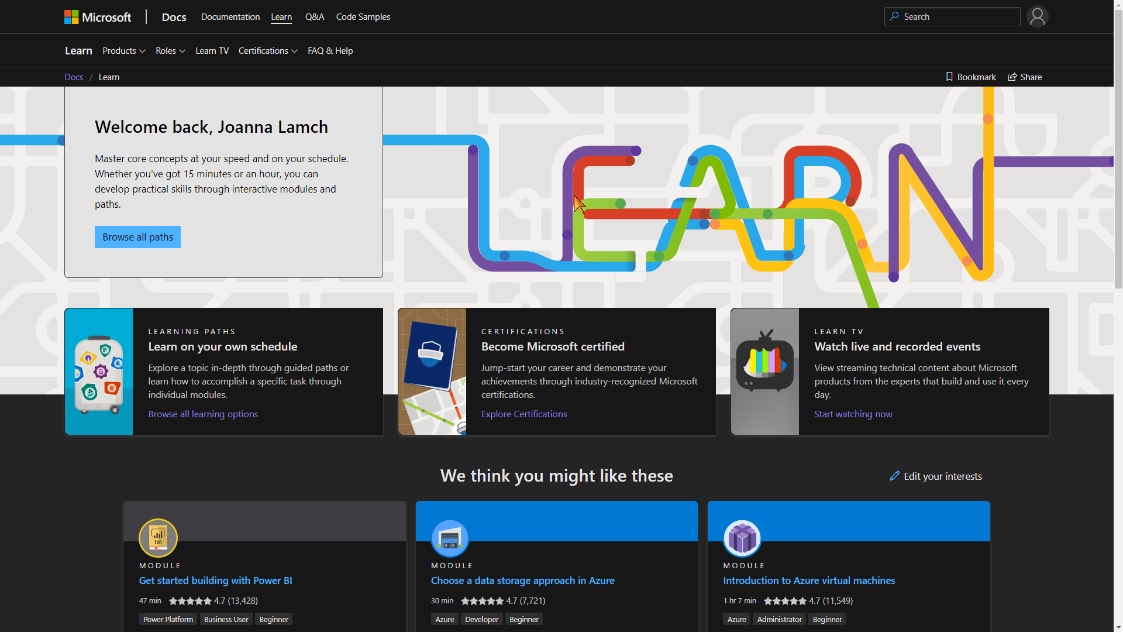
Learn? Microsoft Learn
https://docs.microsoft.com/en-us/learn/

Slide 24
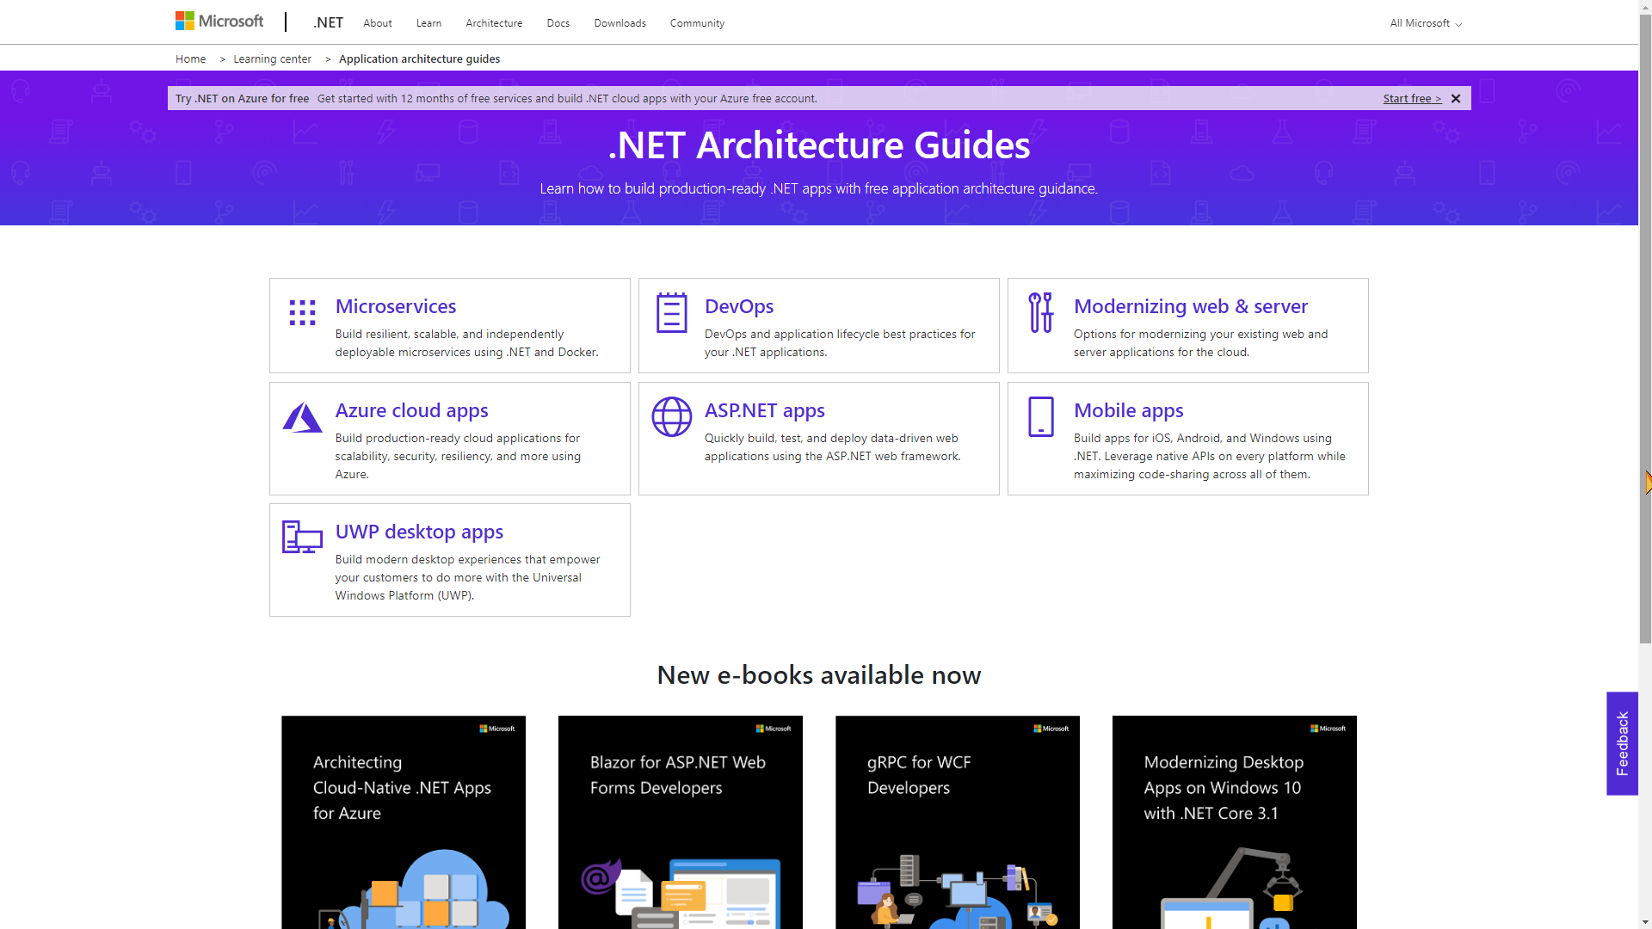
https://github.com/dotnet-architecture
https://dotnet.microsoft.com/learn/dotnet/architecture-guides
Notes:
https://github.com/dotnet-architecture
https://dotnet.microsoft.com/learn/dotnet/architecture-guides

Slide 25
Thanks! Questions?

